Slide 1
In this lecture, I will explain you numpy empty function (np.empty) and will show you how to create an empty array in numpy.

Slide 2
When you first run the empty() function, you might expect it to be “empty. But that’s not right.
The empty() function actually fills the array with arbitrary values or you can say garbage values.

Slide 3
Let’s take a look at the syntax.
There are three parameters that specify the structure of the resulting array.
1. shape
2. dtype
3. order

Slide 4
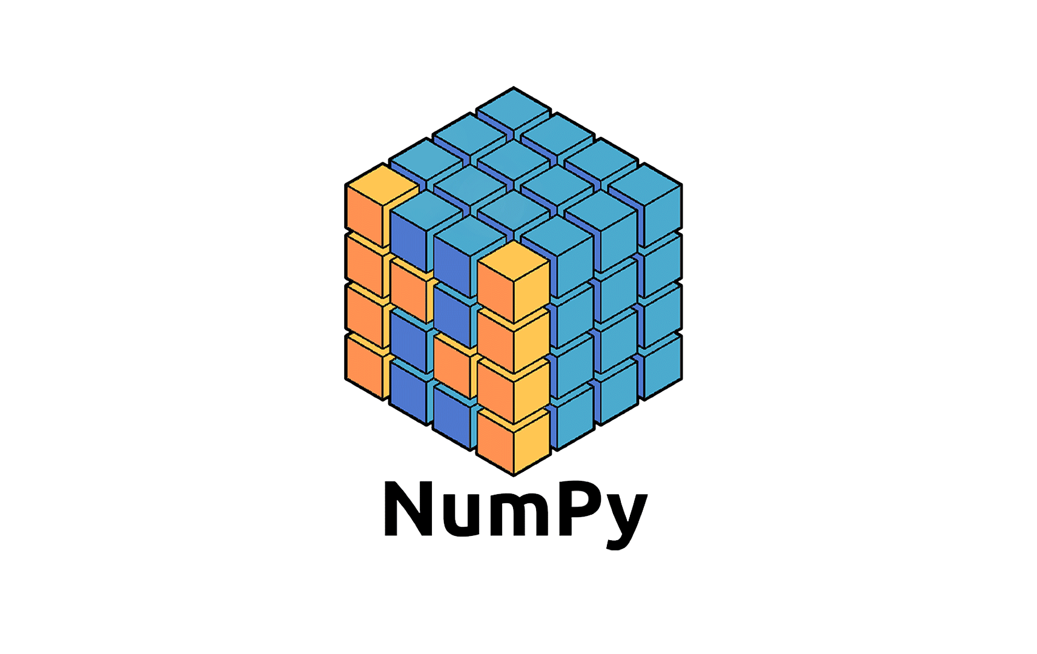
Numpy
Part 14
Arvind Kharwal
www.Kharwal.com

Slide 5
Numpy Operations

Slide 6
Empty Function

Slide 7
The empty() function is used to create a new array of given shape and type, with random values.
The empty() function actually fills the array with arbitrary values.

Slide 8
Syntax:
numpy.empty(shape, dtype=float, order='C')

Slide 9
Shape: Required
The shape parameter specifies the “shape” of the array that you want to create. The shape is essentially the number of rows and the number of columns (if you have a 2D array).

Slide 10
The argument to shape will be an integer, or a tuple of integers or a list of integers.
If you only provide an integer n, then output will be a numpy array with n values.
But if you provide a tuple or list of values, [n, m], NumPy empty will create an array with n rows and m columns.

Slide 11
dtype: This parameter specify the data type of the data in the new array.
Optional.
float64 as the default data type.

Slide 12
order: Optional
This parameter defines the order in which the multi-dimensional array is going to be stored either in row-major or column-major.
By default, the order parameter is set to 'C'.

Slide 17
Thank You

